Slide 1


What is the difference?
A comparison of reddit user’s behaviors from 2013 to 2018
2018.12.04

Slide 2
1
Data Mining & Processing
2
Clustering & Comparing
CONTENTS
3
Classification & Prediction
4
Business Outlooks

Slide 3
Data Mining & processing
PART
01
Use Praw/Psaw packages to scrape the data from Reddit world-news community
Process the data, based on the single post, separate the comments
Process the comments (sentiment analysis/language expression analysis…)
Final columns: title, text, ups, downs, main comment, sub comment, main pos/neg/sentiment, sub pos/neg/sentiment, main/sub mimic.
Notes:
模板来自于 http://meihua.docer.com/

Slide 4
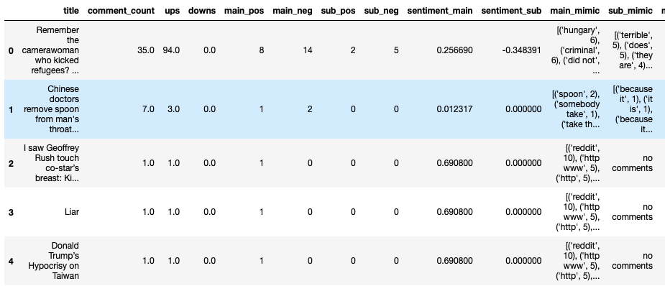
A sample of the data.
From October 1st to November 1st 2018

Slide 5
Clustering & Comparing
PART
02
We used hierarchical clustering to do the cluster, cause its parameter is controllable, which make it easier to be tuned. ( At first the topics are classified by hand!!)
From the data we’ve collected from 2018 and 2013, we can attribute the top ten topics and do some analysis
Notes:
模板来自于 http://meihua.docer.com/

Slide 6
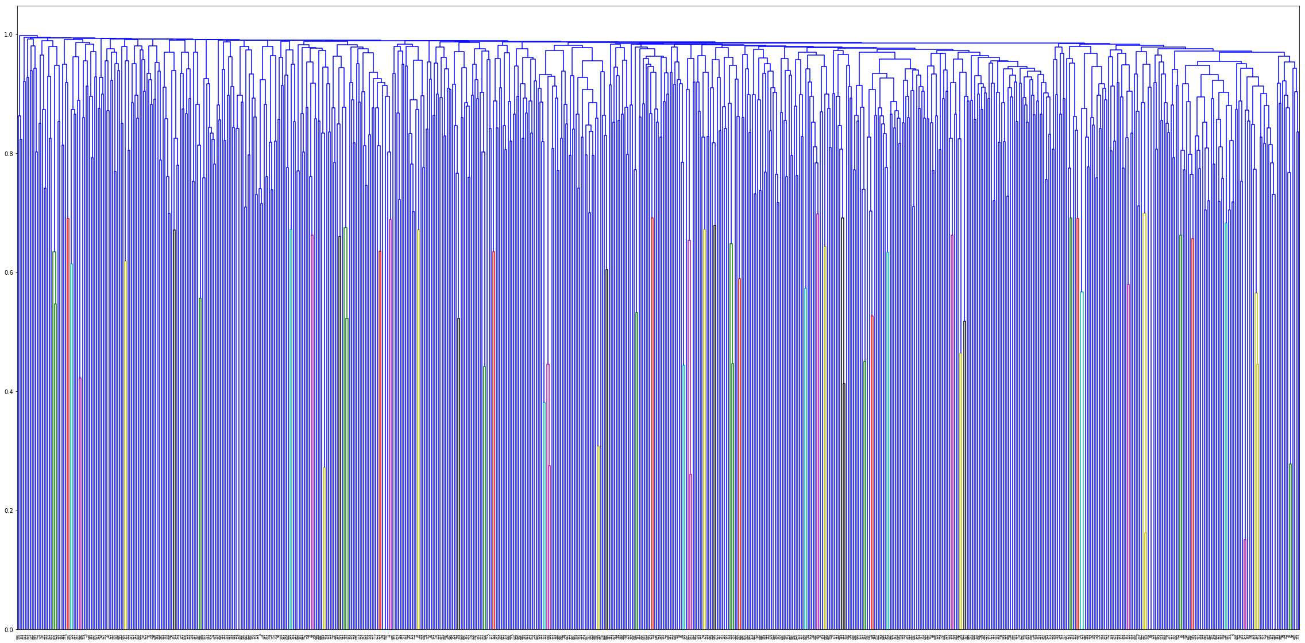
clustering
This is the data from 2013
The distance is 0.985

Slide 7
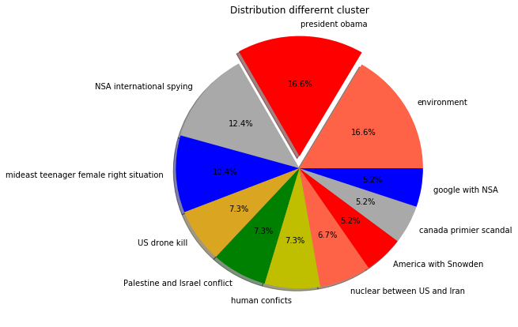
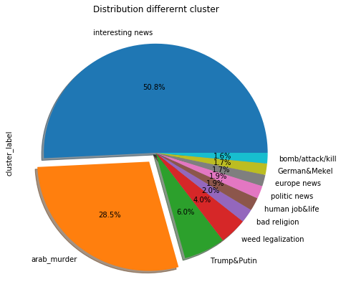
There are some interesting results…
This is the data from 2013 and 2018
The different topics
2018
2013

Slide 8
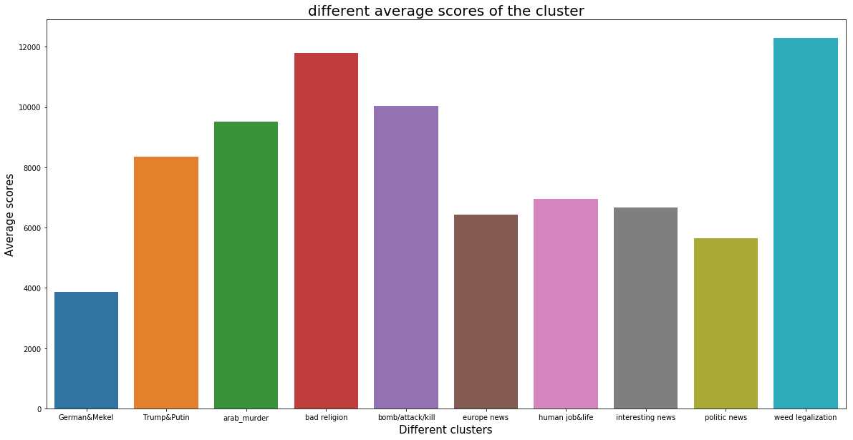
Comparing
This is the data from 2013 and 2018
Scores of topics in 2018

Slide 9
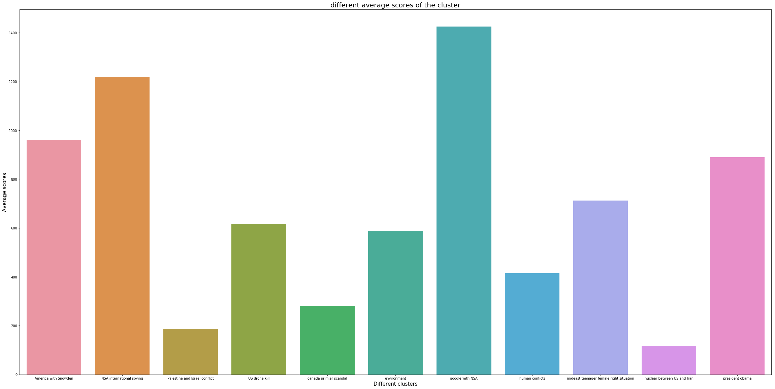
Comparing
This is the data from 2013 and 2018
Scores of topics in 2013

Slide 10
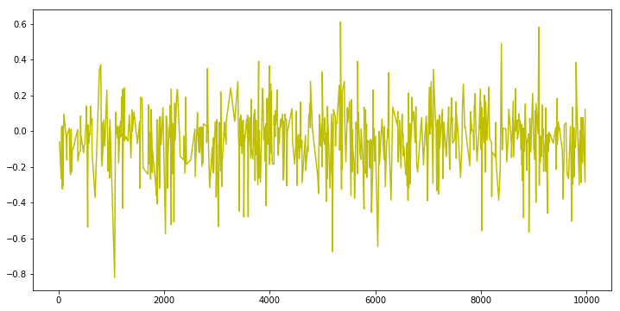
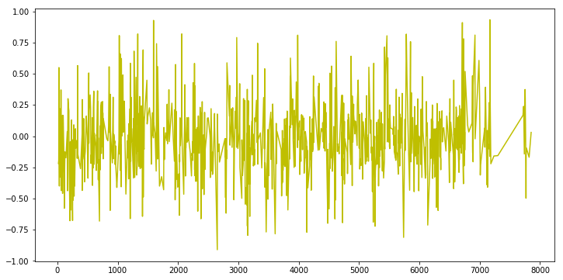
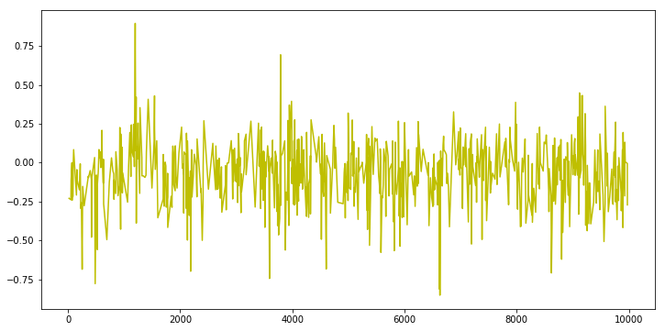
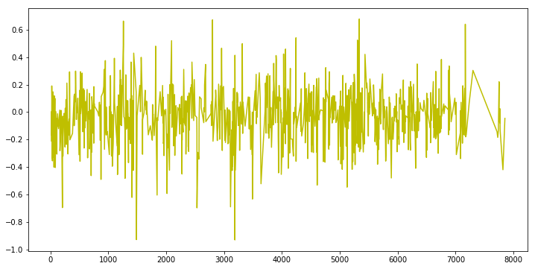
Comparing
This is the data from 2013 and 2018
Average sentiment score
The main/sub sentiment score of 2018 is -0.02774 and -0.03591
The main/sub sentiment score of 2013 is -0.06573 and -0.04556

Slide 11
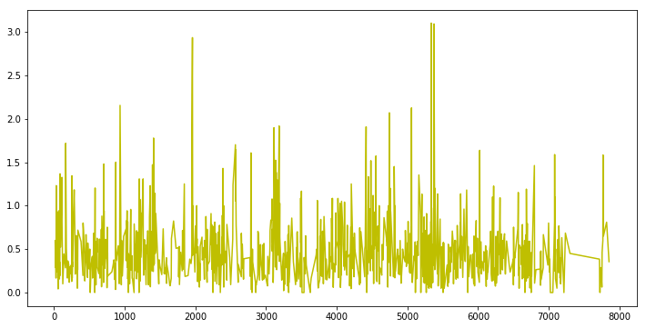
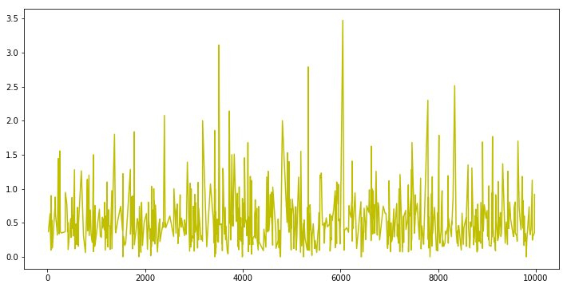
Comparing
This is the data from 2013 and 2018
The dirty talk rate
The average dirty words per single comment in 2018 is
0.4758
The average dirty words per single comment in 2013 is
0.5419

Slide 12
Classification & Prediction
PART
03
Use text title which can generate tf-idf matrix to do the classification.
Predict whether the news will become hot or not
And predict the sentiment of comment for these news will be positive or negative
Notes:
模板来自于 http://meihua.docer.com/

Slide 13
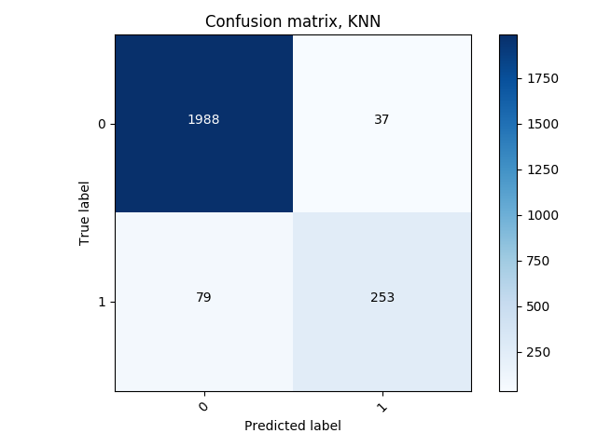
Comparing
This is the data from 2013 and 2018
Comment number > 10. HOT!
Accuracy: 88.33%

Slide 14
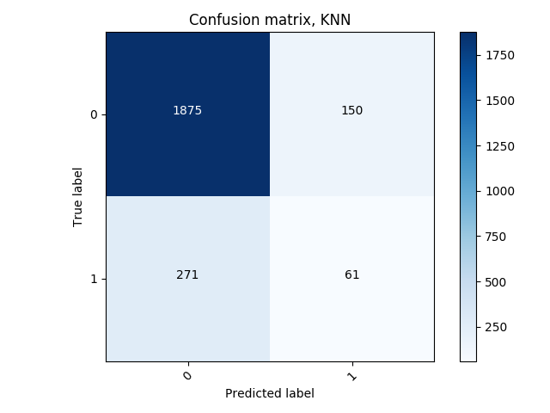
Comparing
This is the data from 2013 and 2018
Decline last_time !
Accuracy: 76.31%

Slide 15
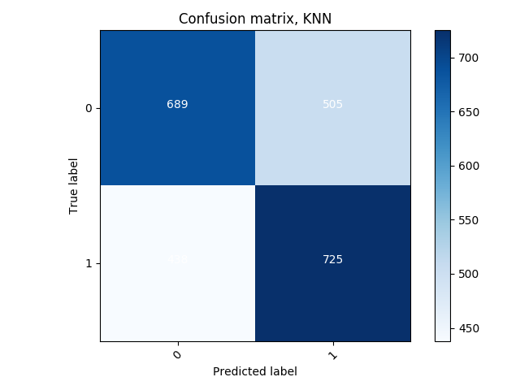
Comparing
This is the data from 2013 and 2018
Top 25% HOT！
438

Slide 16
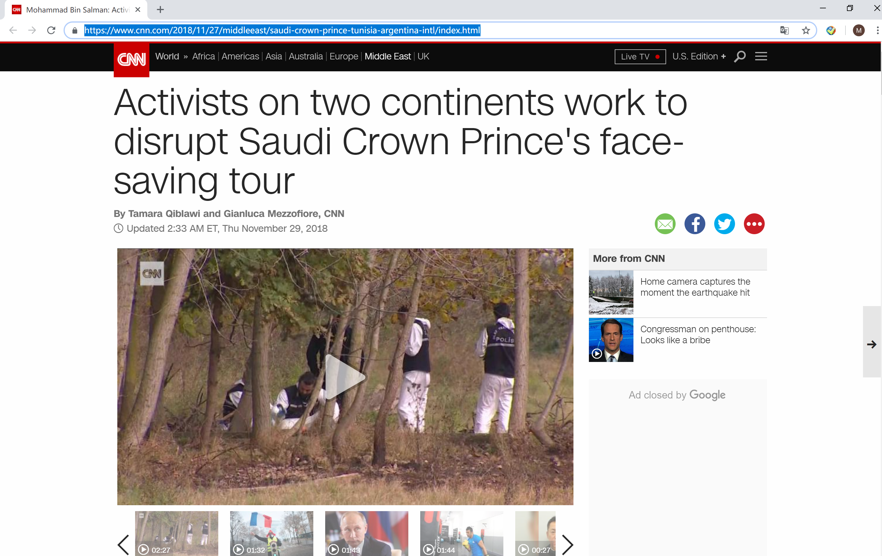
Prediction
Step1：Get the URL of the news

Slide 17
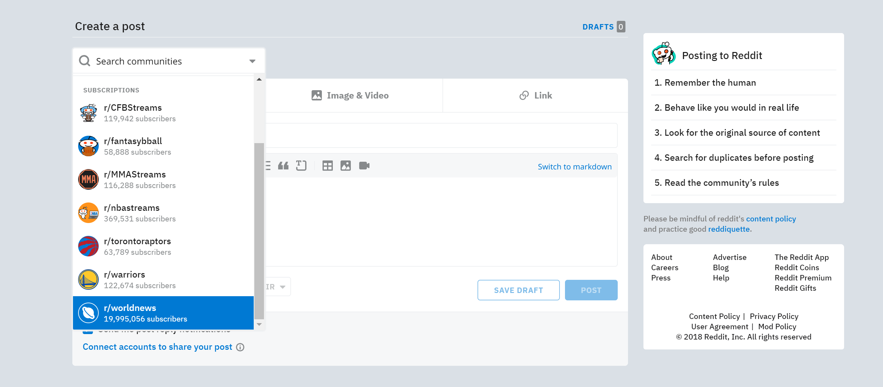
Prediction
Step2：Create a new post on r/worldnews

Slide 18
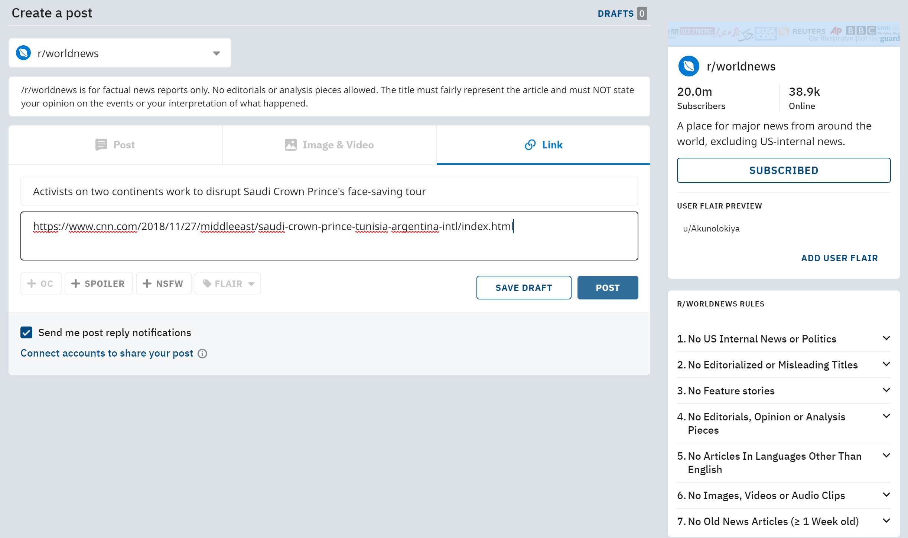
Prediction
Step3：Paste the URL of the news into the link

Slide 19
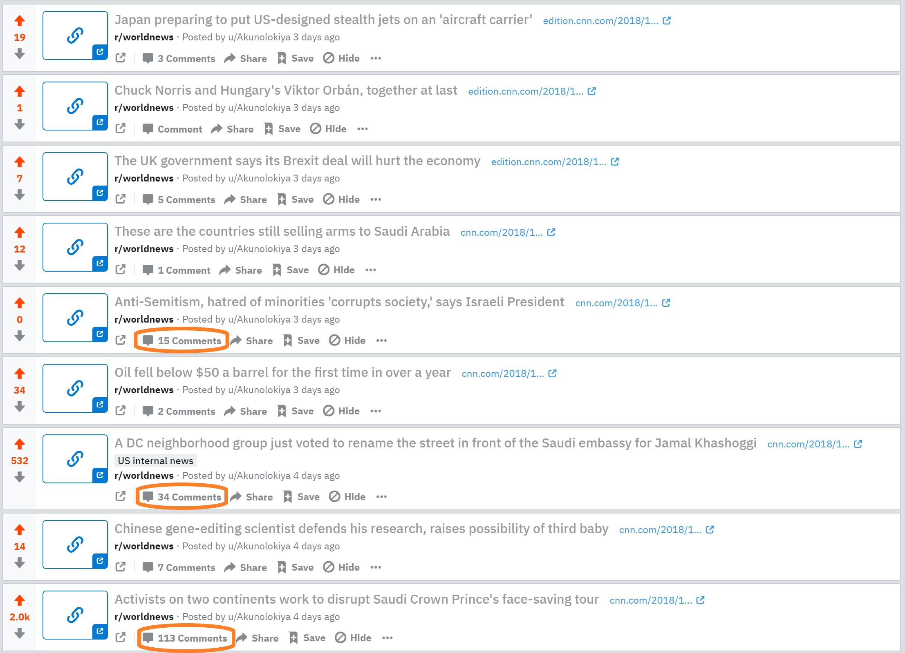
Prediction
Step4：See the results of the posted news

Slide 20
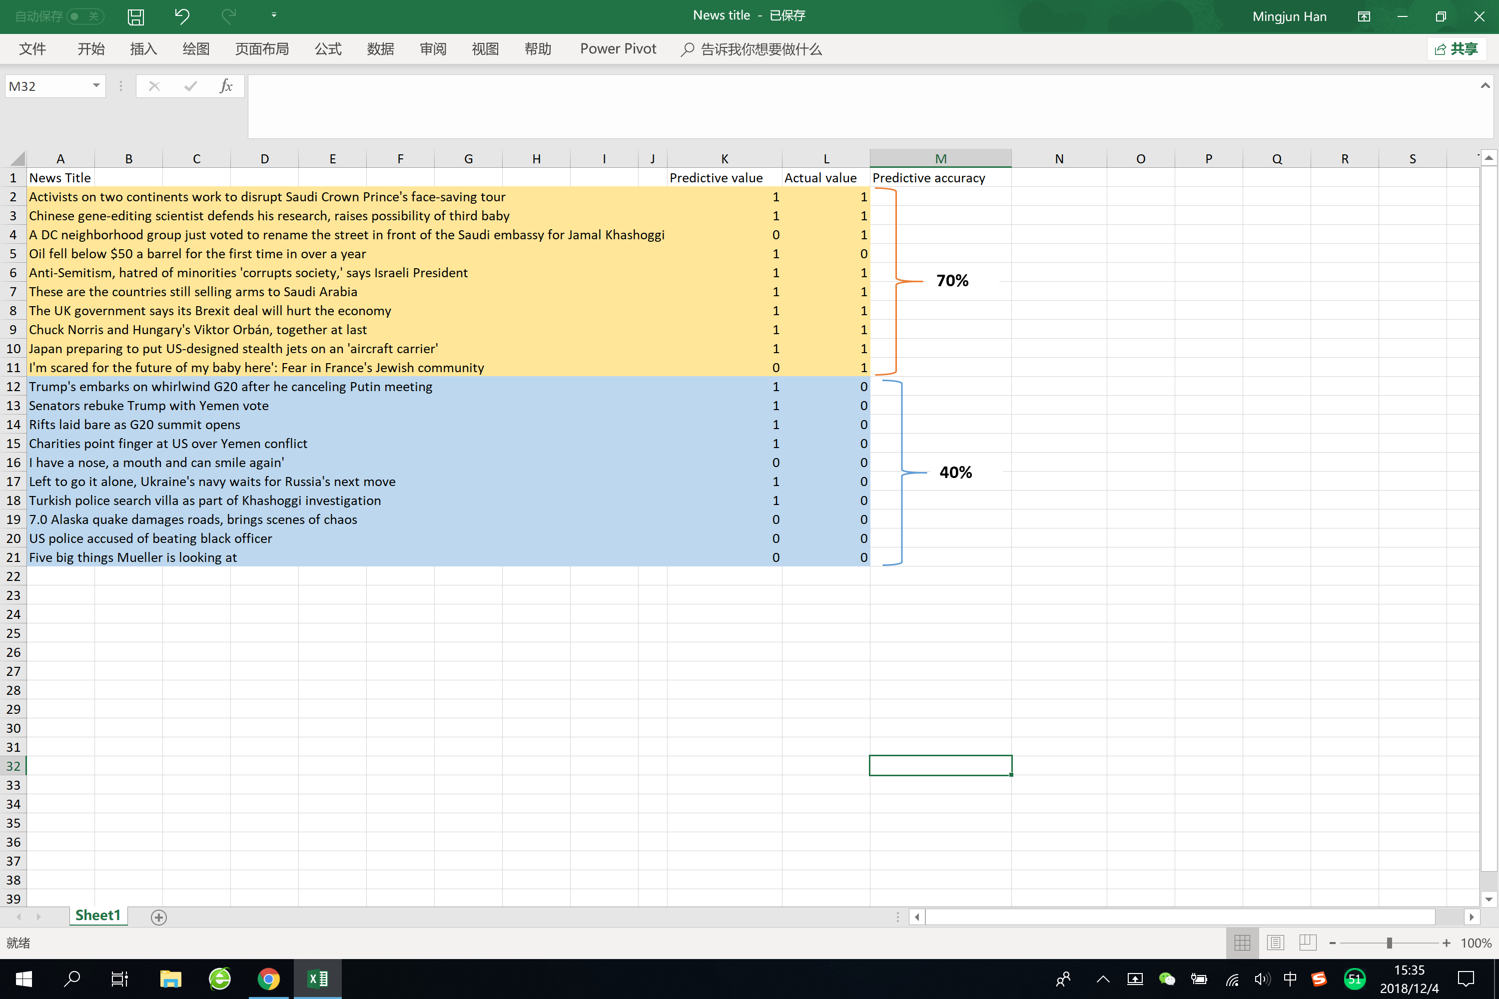
Prediction
Step5：Compare with predicted results
Somehow our account was blocked during 2nd experiment

Slide 21
Business Outlooks
PART
04
By using our predictive model, we can predict what topics people are more likely to be interested in, or we can use it to test whether a post will be popular among people nowadays.
Some merchants will advertise in advance when they know what kind of products may be popular.
We can change people’s opinions by sending out some posts that may be popular, and lead more people into today’s trend.
Notes:
模板来自于 http://meihua.docer.com/

Slide 22
Conclusion
The number of topics that reddit users are concerned with is reduce as well as the US interventions. Trump's isolation policy is effective.
Reddit users' attitudes and civilization are improving. Maybe people are becoming more civilized, or reddit administrators are even better.
Our predictive model performs well without the intervention of the reddit management system.

Slide 23
Thank you for watching !
2018.12.4

